Slide 1

Reflex arc
GTHBY Human Biology

Slide 2
Review
1.List and draw three types of neurons.
2.Which part of the CNS controls voluntary/conscious actions, such as reaction time.
3.Why is the skin described as a general receptor rather than a specific receptor?
4. Which part of the brain works with sensory information from the skin?
5. Why are some parts of the skin more sensitive than others?

Slide 3
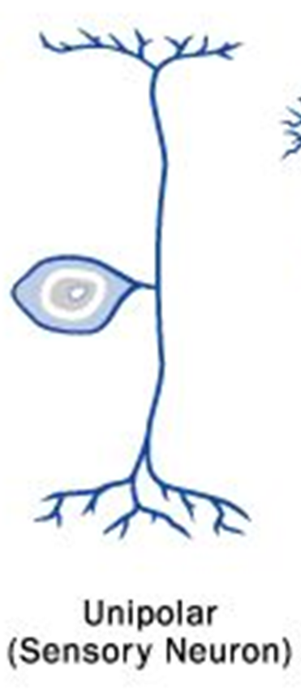
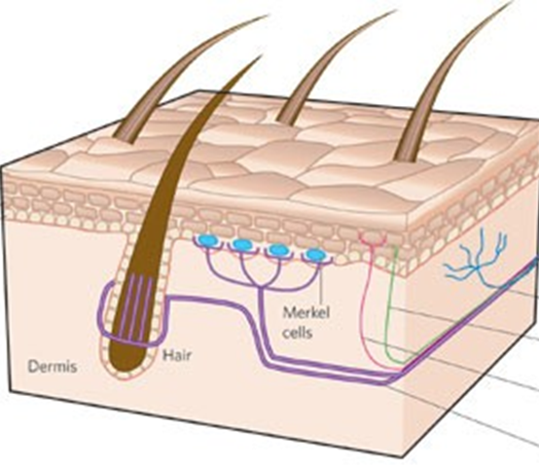
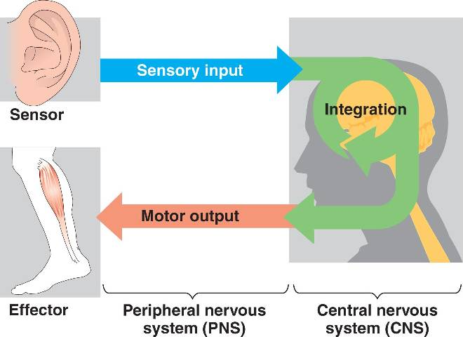
Primary Functions
Sensory (afferent) neurons
Interneurons
Motor (efferent) neurons

Slide 4
Learning Intentions
Components of the reflex arc

Slide 5
Success Criteria
Draw a reflex arc showing all the nerves involved.
Explain why the CNS component of the reflex arc is the spinal cord not the brain.
Describe two reflexes in adults.

Slide 6
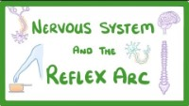

Slide 7
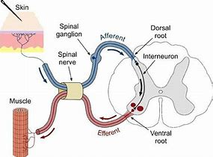

Slide 8
Success Criteria
Draw a reflex arc showing all the nerves involved.
Explain why the CNS component of the reflex arc is the spinal cord not the brain.
Describe two reflexes in adults.

